Slide 1
INF10025
Data Management and Analytics
Lecture 7 – Part 1
Composite Keys
Weak Entities

Slide 2
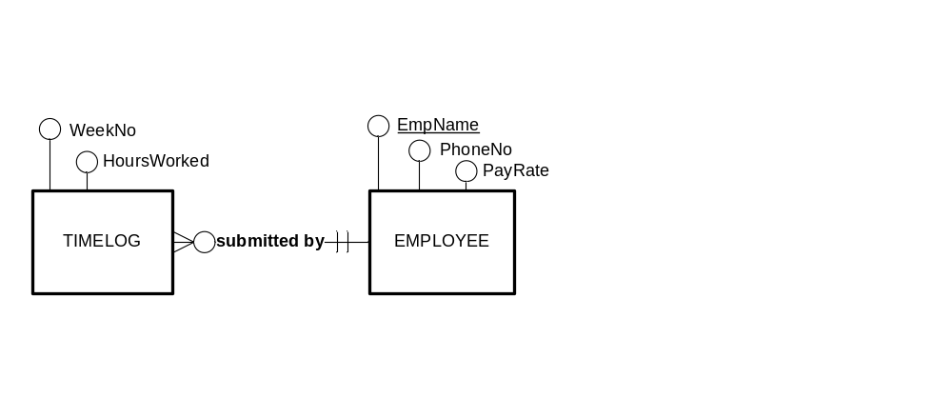
Natural Keys recap
  We have discussed the notion of Natural Keys
  If an organisation does not have an Employee No associated with each employee, then we could use employee name as a PK
        EMPLOYEE(EmpName, PhoneNo, PayRate)
        TIMELOG(WeekNo, HoursWorked, EmpName)
        FK (EmpName) references EMPLOYEE

Slide 3
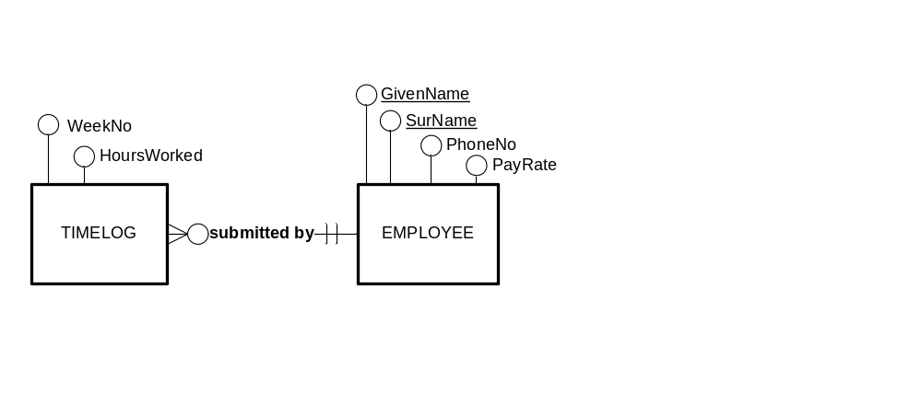
Composite Keys
  We have also discussed the notion of Composite Keys.
  This is where the Primary Key is made up of values from multiple columns
        EMPLOYEE(GivenName, Surname, PhoneNo, PayRate)

Slide 4
Composite Keys
  When the Primary Key is made up of values from multiple columns,
  then any Foreign Key must also be an identical match for the Primary Key
        EMPLOYEE(GivenName, Surname, PhoneNo, PayRate)
        TIMELOG(WeekNo, HoursWorked, GivenName, Surname)
        FK (GivenName, Surname) references EMPLOYEE

Slide 5
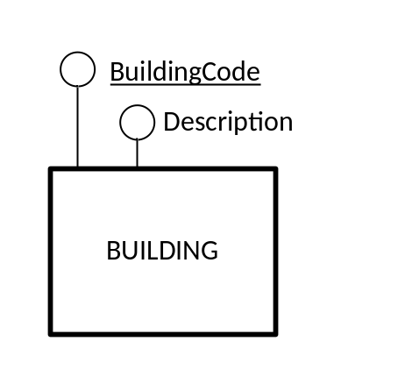
Strong and Weak entities
An entity is a person, place, object, event or concept.
  Entities can be classified into two groups
    Strong Entities
    Weak Entities
So far we have only focused on Strong Entities
A strong entity is :
  "An entity type that exists independently on other entity types"
– Hoffer Prescott McFadden
  "An entity type that is not existent-dependent on some
  other entity type" – Connolly & Begg
Therefore a strong entity can be identified by its own attributes.
That is a identifier can be chosen from its own attributes
For example, BUILDING is a strong entity

Slide 6
Strong and Weak entities
Consider the buildings at Swinburne University. E.g. The BA Building
  It has a building code: BA
  It has a description: Business Arts
The Building entity is a strong entity

Slide 7
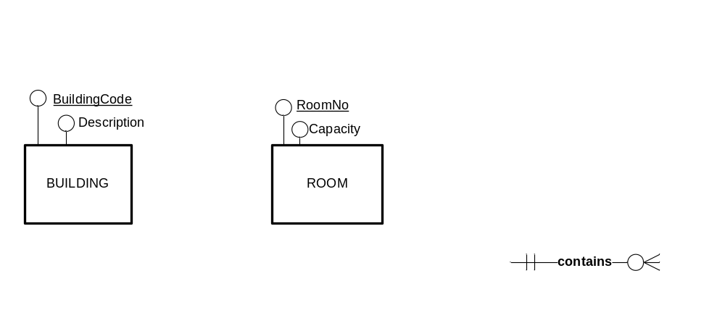
Weak Entities
We also know the following information about a room. e.g.:
  RoomNo 403
  RoomDesc Lecture Theatre
  Capacity 85
  Building BA
Our two Entities might look like this:
Rule of ERDs:
An attribute must only appear once in an ERD

Slide 8
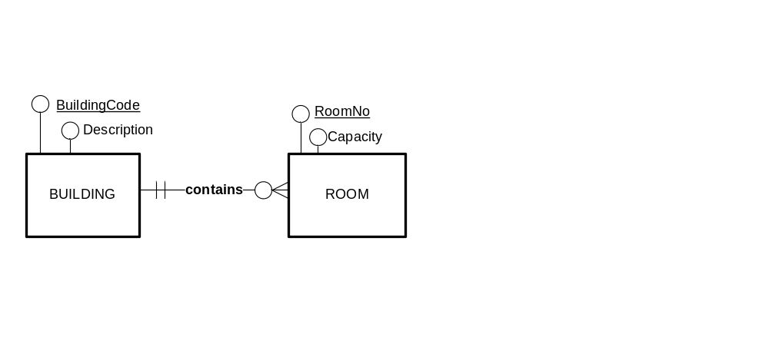
Borrowed Identifiers
There is a relationship between Room and Building
  The diagram shows that a Room must be contained in one building.
    "One Room Must be Contained in One Building"
    "One Building May Contain Many Rooms"
  We can easily 'navigate' the relationship to the building code.

Slide 9
Borrowed Identifiers
Is the attribute RoomNo enough to identify a room? NO!
  Swinburne has many rooms with RoomNo 403.
  (403 in the EN bldg, and 403 in the ATC bldg…)
What then, should the identifier be?
  A composite identifier
  The Identifier for Room must be
  BuildingCode + RoomNo (e.g. BA 403)
Problem:
  BuildingCode is not an attribute of ROOM.

Slide 10
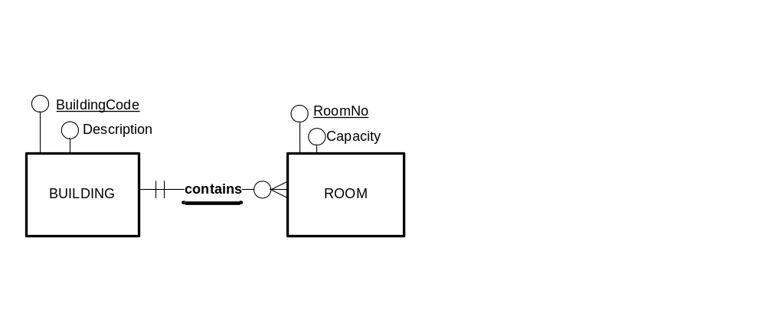
Borrowed Identifiers
How do we indicate that the identifier is borrowed?
  The relationship is part of the identifier,
  so we must underline the relationship name
The entity at the MANY end of the relationship,
uses the identifier at the ONE end of the relationship
as part of its identifier.
The underlined relationship name means:
The identifier of ROOM is: BuildingCode + RoomNo

Slide 11
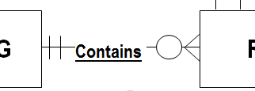
Underlined relationship name
The underline is important

Slide 12
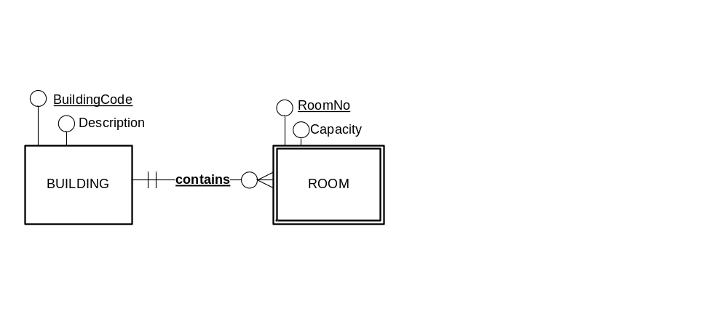
Weak Entities
A weak entity is
  " …an entity type that borrows part of, or all of its … identifier…" - Mannino
Thus, ROOM is a WEAK entity.
  The identifier of Room is partially or fully defined by identifier
  from other related entities.
WEAK entities are drawn with a double outline

Slide 13
Weak Entities
What does the ERD below tell us?:
  RoomNo is underlined. It must be part of the identifier of ROOM
  The double outline indicates that the ROOM is a weak entity
        So part of the ROOM's identifier must be 'borrowed'.
  The relationship named 'contains' is underlined
        So the identifier at the many end
        borrows the identifier from the one end of the relationship
  The Identifier of Room is BuildingCode + RoomNo

Slide 14
Revised ERD – RM Conversion
An ERD with a one-to-many relationship can be converted to a Relational Schema using the following steps:
  Create a table for each entity
  BUILDING, ROOM
  Make each attribute a column
    BUILDING ( BuildingCode, Description )
    ROOM (RoomNo, Capacity )
  For each strong entity, choose an identifier as a PRIMARY KEY
  BUILDING ( BuildingCode, Description )

Slide 15
Revised ERD – RM Conversion
  Take the Primary Key at the one end of the relationship and
  make it into a Foreign Key at the many end.
  BUILDING ( BuildingCode, Description)
  ROOM (RoomNo, BuildingCode, Capacity)
  If the entity at the many end uses a borrowed identifer,
  then make the foreign key part of the PRIMARY KEY.
  BUILDING ( BuildingCode, Description)
  ROOM (RoomNo, BuildingCode, Capacity)

Slide 16
ERD – RM Conversion
By convention, we tend to list the borrowed attribute first.
ROOM ( BuildingCode, RoomNo, Capacity )
BUILDING ( BuildingCode, Description )
FK

Slide 17
FK key is also composite
CompID
Description
Location for
COMPUTER
If a foreign key references a PK which is a composite key,
then the FK must be a composite
COMPUTER (Compid, Description, BuildingCode, RoomNo)
Primary Key (Compid)
Foreign Key (BuildingCode, RoomNo) references ROOM

Slide 18
SQL if composite keys are used
CompID
Description
Location for
COMPUTER
When composite PK and FKs are used, then the ON clause requires
all columns of the PK & FK to be specified
SELECT *
FROM ROOM R
INNER JOIN COMPUTER C
ON C.BuildingCode = R.BuildingCode AND C.RoomNo = R.RoomNo

